Slide 1

AC22005
Section 2 - Lecture 8
Microprocessors 2 (addressing)

Slide 2
Outline of today’s lecture
  instruction sets / formats
  data types
  the programmer’s model
  Reference: Stallings, “Computer Organization and Architecture” (5th Ed.), chapters 9 and 10

Slide 3

Thought for the Day

Slide 4


Graph of the Day

Slide 5

If this is the answer, what is the question … ?

Slide 6
Revision - machine code
The fetch-execute cycle of the processor is “feeding” on the sequence of binary data drawn from the memory. If fetched during an instruction fetch cycle, a word of data will be interpreted by the CPU as an instruction.
1 10 100 10 1000 10 10
10 100 10 1000 10 100
0 100 10 1 10 10 1 1 10 1
1 10 10 100 1000 10 10
1 10 10 10 10 1000 100
1 10 100 10 1 1 1 10 100
Instruction
Operand
Instruction
Instruction
Operand
Instruction
1 10 100 10 1000 10 10
10 100 10 1000 10 100
0 100 10 1 10 10 1 1 10 1
1 10 10 100 1000 10 10
1 10 10 10 10 1000 100
1 10 100 10 1 1 1 10 100
Opcode
Addressing mode
Operand

Slide 7
Instruction sets
  types of operations
  types of operands (data types)
  instruction format:
    length, size of specific fields
  addressing modes:
    how to specify access to the operands
Typically, later processors contain more of all of these features than older processors!
Notes:
AC352 - CPUs
(c) University of Dundee

Slide 8
Elements of an instruction
Each instruction must contain all of the information required by the CPU for execution:
  opcode (operation code)
  operand references (source and destination operands) - can be in:
    CPU register (explicit or implicit)
    main memory (need address or pointer)
  where to fetch the next instruction from (usually implicit - just increment the program counter to the next instruction)
Notes:
AC352 - CPUs
(c) University of Dundee
Each instruction must contain the information required by the CPU for execution
In most cases, the next instruction to be fetched immediately follows the current instruction. In those cases, there is no explicit reference to the next instruction. When an explicit reference is needed, then the main memory or virtual memory address (I.e. in either case the logical address) must be supplied. The form in which that address is supplied varies - see chapter 10.
Source or result operands can be in one of 3 areas:
main or virtual memory - the main or virtual memory address must be supplied
CPU register
If only one register exists, reference to it may be implicit. If more than one register exists, the each register is assigned a unique number, and the instruction must contain the number of the desired register.
I/O device
The instruction must specify the I/O module and device for the operation. If memory mapped I/O is used, this is just another main or virtual memory address

Slide 9
Types of Operations

Slide 10
Typical CPU operations
  data transfer (move, pop etc.)
  arithmetic (add, multiply etc.)
  logical (AND, NOT etc.)
  I/O (read, write etc.)
  flow of control (branches, subroutines etc.)
  conversion (BCD to binary etc.)
  system control (wait, halt etc.)
A typical instruction set will contain many opcodes for each of these types
Notes:
AC352 - CPUs
(c) University of Dundee
The number of opcodes varies widely from machine to machine - however the same general types of operations are found on all machines. Typical characterisation is: data transfer; arithmetic; logical; conversion; I/O; system control; transfer of control.
[Machine instruction types (bottom 3 16-top 3 17): data processing; data storage; data movement; control. See also slide 23 (Instruction formats)]
Common instruction types in each category - See table 9.3 Stallings
Figure 3.5 - arithmetic operations

Slide 11
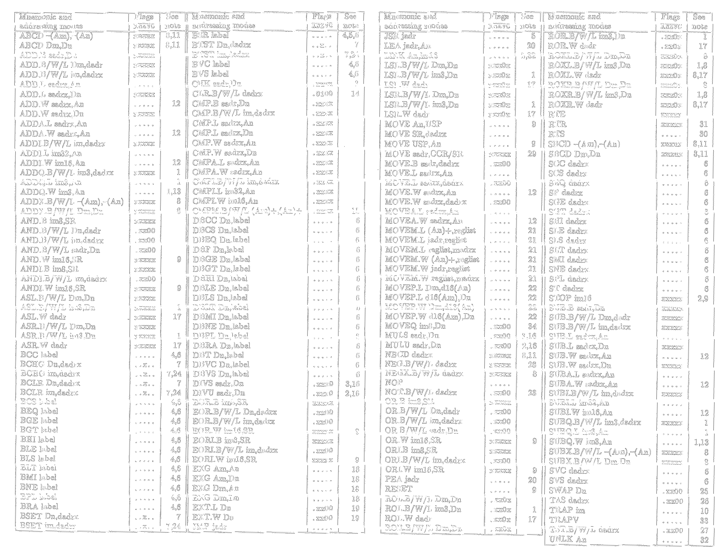
Examples - MC68000 set

Slide 12
Examples
; to code e.g. A = A + B
ADD D1,D2 ; explicit registers
; to code e.g. A = A + 1
ADD #1,D2 ; given number
; to code e.g. A = A + pi
ADD (10000), D2 ; explicit reference
; to code e.g. A = A + B[C]
ADD (A3),D2 ; pointer reference

Slide 13
Instructions
  In a 4-bit microprocessor, there are 2⁴ = 16 possible instruction codes - a bit restrictive
  In an 8-bit microprocessor, there are 2⁸ = 256 possible instruction codes - OK
  In a 16-bit microprocessor, there are 2¹⁶ = 65,536 possible instruction codes – we would never need that many, so let’s just allow for (say) 1,024 (=2¹⁰) and use the other 6 bits for something else
  In a 32-bit microprocessor …
Notes:
AC352 - CPUs
(c) University of Dundee
The operation of the CPU is determined by the instructions it executes - the machine instructions.
The collection of different instructions that the CPU can execute is called the instruction set.
If a programmer is using a high level language - e.g. Pascal, and to a slightly lesser extent, C - very little of the architecture of the underlying machine is visible. One boundary where the computer designer and the computer programmer can view the same machine is in the machine instruction set. From the designer’s point of view, the machine instruction set provides the functional requirements for the CPU. Implementing the CPU is a task that in large part involves implementing the machine language. From the user’s side, the user who programs in machine language (I.e. assembly language) becomes aware of the register and memory structure, and the types of data directly supported by the machine, and the functioning of the ALU.
A description of the machine instruction set goes a long way toward explaining the computer’s CPU.

Slide 14
Instruction components
So, we can thus use some of the spare bits available within the instruction “word” to define the addressing mode, or even include small “immediate” operands (this will save us doing another fetch to get the operand separately).

Slide 15
Instruction formats - design
Instruction length:
  we want the instruction length to divide the width of the data bus exactly
  note that doubling the length of the instruction probably doesn’t make the instructions twice as powerful!
Allocation of bits inside the instruction:
  trade-off between number of opcodes / range of addressing capability / inclusion of small operands within the instruction
Notes:
AC352 - CPUs
(c) University of Dundee
See Stallings p374-7

Slide 16
Instruction format example
15
4
6
6
0
Address field (operand reference)
Address Field (operand reference)
Opcode
The various CPU designs evolved a variety of instruction formats.
Notes:
AC352 - CPUs
(c) University of Dundee
Within computer, each instruction represented as a sequence of bits. Instruction divided into fields.
With most instruction sets, more than one format is used.
Instruction read into instruction register in CPU.
CPU must be able to extract the data from the various instruction fields
Common opcodes: ADD, SUB, MPY, DIV, LOAD, STOR
e.g. ADD R,Y - add the value contained in memory location Y to the contents of register R.
Typically, a high level language instruction requires several machine instructions
Instruction types
Data processing - arithmetic and Boolean
computational capabilities for processing numeric data
logic (Boolean) instructions operate on the bits of a word as bits rather than as numbers - they therefore provide capabilities for processing any other type of data the user may wish to employ
Data storage - Memory instructions
arithmetic and Boolean operations are performed primarily on data in CPU registers. Therefore, there must be memory instructions for moving data between memory and the registers
Data movement - I/O instructions
needed to transfer programs and data into memory and the results of computations back out to the user
Control - test and branch instructions
Test - to test the value of a data word or the status of a computation
Branch to a different set of instructions depending on the decision made

Slide 17
Instruction format examples
15
4
6
6
0
Address field (operand reference)
Address Field (operand reference)
Opcode
… OR ...
15
4
2
5
5
0
Address
field
Address
Field
Opcode
Mode
Addressing Mode to be used
Notes:
AC352 - CPUs
(c) University of Dundee
Within computer, each instruction represented as a sequence of bits. Instruction divided into fields.
With most instruction sets, more than one format is used.
Instruction read into instruction register in CPU.
CPU must be able to extract the data from the various instruction fields
Common opcodes: ADD, SUB, MPY, DIV, LOAD, STOR
e.g. ADD R,Y - add the value contained in memory location Y to the contents of register R.
Typically, a high level language instruction requires several machine instructions
Instruction types
Data processing - arithmetic and Boolean
computational capabilities for processing numeric data
logic (Boolean) instructions operate on the bits of a word as bits rather than as numbers - they therefore provide capabilities for processing any other type of data the user may wish to employ
Data storage - Memory instructions
arithmetic and Boolean operations are performed primarily on data in CPU registers. Therefore, there must be memory instructions for moving data between memory and the registers
Data movement - I/O instructions
needed to transfer programs and data into memory and the results of computations back out to the user
Control - test and branch instructions
Test - to test the value of a data word or the status of a computation
Branch to a different set of instructions depending on the decision made

Slide 18
Data Types

Slide 19
Data types for operands
Important general categories of data that machine instructions operate on:
  addresses (often need to calculate operand address - usually consider addresses as unsigned integers)
  numbers: integer, floating point, packed decimal
  characters: ASCII
  logical data: word viewed as N 1-bit items
Notes:
AC352 - CPUs
(c) University of Dundee
Machine instructions operate on data. The most important general categories are: addresses, numbers, characters, logical data. Note - some machines define specialised data type or data structures. For example, there may be machine operators that operate directly on a list or a string of characters.
addresses -
in many cases, some calculation must be performed on the operand reference in an instruction to determine the main or virtual memory address. In this context, addresses can be considered to be unsigned integers.
Numbers
even in nonnumeric data processing, there is a need for numbers to act as counters, field widths and so on
numbers stored in a computer are limited - in magnitude, and (in the case of floating point numbers) - in precision. So the programmer is faced with understanding the consequences of rounding, overflow and underflow
rounding (floating point)- the result of any operation on significands is generally stored in a longer register - when the result is put back into floating point format, the extra bits must be disposed of. So have a rounding policy - e.g. round: toward nearest; toward +infinity; toward -infinity; toward 0
overflow(floating point) - arithmetic op results in a magnitude greater than can be expressed with exponent - I.e. v big +ve or -ve numbers
underflow (floating point) - when fractional magnitude too small - I.e. v. small +ve or -ve numbers.
Characters -
ASCII - 7 bit code (to represent printable or control character) and a parity bit (total number of 1s in each octet even (even parity) or odd (odd parity). Note that digits 0 through 9 represented by 0 1 1XXXX, where XXXX is the binary equivalent (0000 through 100 1) - same code as packed decimal - facilitates conversion.
Logical
2 advantages to bit oriented view: memory can be used efficiently for storage of an array of Boolean (true/false) values; when need to manipulate bits of a data item, e.g. shifting significant bits in some floating point operations, extracting rightmost bits of each byte when converting from ASCII to packed decimal

Slide 20
Data types for operands
Remember (again) that all of these data types are stored in memory locations as binary numbers!
However, certain instructions can manipulate these numbers as though they are more sophisticated data types.
Notes:
AC352 - CPUs
(c) University of Dundee
Machine instructions operate on data. The most important general categories are: addresses, numbers, characters, logical data. Note - some machines define specialised data type or data structures. For example, there may be machine operators that operate directly on a list or a string of characters.
addresses -
in many cases, some calculation must be performed on the operand reference in an instruction to determine the main or virtual memory address. In this context, addresses can be considered to be unsigned integers.
Numbers
even in nonnumeric data processing, there is a need for numbers to act as counters, field widths and so on
numbers stored in a computer are limited - in magnitude, and (in the case of floating point numbers) - in precision. So the programmer is faced with understanding the consequences of rounding, overflow and underflow
rounding (floating point)- the result of any operation on significands is generally stored in a longer register - when the result is put back into floating point format, the extra bits must be disposed of. So have a rounding policy - e.g. round: toward nearest; toward +infinity; toward -infinity; toward 0
overflow(floating point) - arithmetic op results in a magnitude greater than can be expressed with exponent - I.e. v big +ve or -ve numbers
underflow (floating point) - when fractional magnitude too small - I.e. v. small +ve or -ve numbers.
Characters -
ASCII - 7 bit code (to represent printable or control character) and a parity bit (total number of 1s in each octet even (even parity) or odd (odd parity). Note that digits 0 through 9 represented by 0 1 1XXXX, where XXXX is the binary equivalent (0000 through 100 1) - same code as packed decimal - facilitates conversion.
Logical
2 advantages to bit oriented view: memory can be used efficiently for storage of an array of Boolean (true/false) values; when need to manipulate bits of a data item, e.g. shifting significant bits in some floating point operations, extracting rightmost bits of each byte when converting from ASCII to packed decimal

Slide 21
Data Types in the Pentium
General data types:
  byte, word ( 16 bits), doubleword (32 bits), quadword (64 bits)
Specific data types - recognised and operated on by particular instructions:
  integer, ordinal, unpacked BCD, packed BCD, near pointer, bit field, byte string, floating point
See Stallings (chapter 8) for details on performing arithmetic with these data types.
Notes:
AC352 - CPUs
(c) University of Dundee
General - arbitrary binary contents
Integer - signed binary value contained in a byte, word or double word, using 2’s compliment representation
Ordinal - unsigned integer contained in a byte, word or double word
Unpacked BCD - one digit in each byte - value in range 0 - 9
Packed BCD - two BCD digits in each byte - value in range 0 to 99
Near pointer - 32 bit effective address that represents the offset within a segment. Used for all pointers in a non-segmented memory and for references within a segment in a segmented memory.
Bit field - A contiguous sequence of bits in which the position of each bit is considered as an independent unit. A bit string can begin at any bit position of any byte and can contain up to (2 power 32) - 1 bits.
Byte string - A contiguous sequence of bytes, words, or doublewords, containing from 0 to (2 power 32) - 1 bytes
Floating point
This type refers to a set of types that are used by the floating point unit and operated on by floating point instructions. Floating point instructions can operate on integers and packed decimal as well as floating point numbers. The integers are in 2’s compliment representation and may be 16, 32 or 64 bits long. Packed decimal integers are stored in sign-magnitude representation with 18 digits in the range 0 through 9. The three floating point representations conform to the IEEE 754 standard.

Slide 22
Instruction Formats

Slide 23
CISC vs. RISC
Early CPU development tended towards Complex instruction sets:
  single instructions could perform complex addressing and functions
  easier support for high-level data structures
  … but some instructions s-l-o-w to process
The idea of RISC was:
  only support simple instructions
  CPU optimised to process these very FAST
  … but compiler has to do more work

Slide 24
Enlarging the set
In the move from 8- to 16- then 32-bit fetches, the additional bits in the instruction could be used to expand:
  the opcode set (some enlargement useful to handle additional instructions)
  the addressing modes (improve flexibility of processor to support compilers)
  the operands (to include some operands within the instruction, thereby reducing the need to fetch operands separately)

Slide 25
Pentium® Instruction Formats

Slide 26
Pentium® instruction format
The instruction sets in the Pentium series have a more complicated instruction format than other modern processors, due to the need for backward compatibility with older 80x86 CPUs (which were CISC designs) … whilst the Pentium implemented some RISC concepts, it had to continue to support its CISC legacy!
Notes:
AC352 - CPUs
(c) University of Dundee
bottom page 383-page 384

Slide 27
Pentium® instruction format
  variety of instruction formats
  only the opcode field is always present
  instructions consist of:
    0 to 4 optional instruction prefixes
    a one- or two-byte opcode
    an optional portion that specifies the addressing mode to be used
    an optional “displacement”
    an optional “immediate field”
Notes:
AC352 - CPUs
(c) University of Dundee
see Stallings 380-4

Slide 28
Later Pentiums®
Due to the increase in signal data needing to be processed (audio, video, internet signals etc.), recent versions of processors have been incorporating instructions and data types more conventionally associated with Digital Signal Processors - this began with the Pentium with MMX (MultiMedia eXtensions).
Signal processing tends to us small code loops which large amounts of data are fed through.*
* more on this in AC41003 Multimedia: Audio

Slide 29
MMX – MultiMedia eXtensions(?)
  8 new 64-bit MMX registers (actually used parts of existing 80-bit FP registers)
  4 new MMX data types (packed bytes, packed words, packed double words, and quad word)
  57 new MMX instructions
  a key feature is the Single-Instruction Multiple-Data (SIMD) concept - allows multiple data words to be calculated upon together, hence saving processor time

Slide 30
Later Pentiums®
Almost all of the instructions and data types which have been added to processors over the last 15 years have been associated with signal processing improvements.
Hardware to handle these extra instructions, as well as the increased size of all the registers, has resulted in the vast increase in the number of transistors in our CPUs.
This in turn has been facilitated by decreasing transistor size via better silicon technology.

Slide 31
Good news all round
Larger word size (cf. early microprocessors) means that:
  larger data can be handled by a single operation
  more instructions are available
  more addressing modes are available
  small operands can be combined with opcodes, reducing the number of operand fetches which are required
Notes:
AC352 - CPUs
(c) University of Dundee
General - arbitrary binary contents
Integer - signed binary value contained in a byte, word or double word, using 2’s compliment representation
Ordinal - unsigned integer contained in a byte, word or double word
Unpacked BCD - one digit in each byte - value in range 0 - 9
Packed BCD - two BCD digits in each byte - value in range 0 to 99
Near pointer - 32 bit effective address that represents the offset within a segment. Used for all pointers in a non-segmented memory and for references within a segment in a segmented memory.
Bit field - A contiguous sequence of bits in which the position of each bit is considered as an independent unit. A bit string can begin at any bit position of any byte and can contain up to (2 power 32) - 1 bits.
Byte string - A contiguous sequence of bytes, words, or doublewords, containing from 0 to (2 power 32) - 1 bytes
Floating point
This type refers to a set of types that are used by the floating point unit and operated on by floating point instructions. Floating point instructions can operate on integers and packed decimal as well as floating point numbers. The integers are in 2’s compliment representation and may be 16, 32 or 64 bits long. Packed decimal integers are stored in sign-magnitude representation with 18 digits in the range 0 through 9. The three floating point representations conform to the IEEE 754 standard.

Slide 32
Brief history of CPU data
1970
1975
1980
1985
1990
1995
2000
2005
2010
“integer” processors
only integer arithmetic - real arithmetic had to be done “long hand” in software
(graphics processors)
maths co-processors
separate processor - real arithmetic only, under control of master processor
“combined” processors
integer and real pipelines in same chip
digital signal processors (DSPs)
optimised for signal processing applications

Slide 33
The Programmer’s Model

Slide 34
The Programmer’s Model
Programmer is not (usually) concerned with:
  details of memory availability
  physical connection of the processor
  the operation or speed of the processor
Programmer is concerned with:
  what registers are available
  what instructions are available
  what addressing modes are available
This forms the programmer’s model.

Slide 35
CPU Schematic
Data registers
Program Counter
D0
PC
D0
Stack Pointer
Address registers
SP
A0
A0
System Buses
Arithmetic/logic unit
Control Unit
ALU
CU
  this forms part of the programmer’s model of the CPU
  the other part is the instruction set of the CPU
Notes:
AC352 - CPUs
(c) University of Dundee
Example processor
MC68000 has 32 bit registers, partitioned into 8 data registers and 9 address registers (includes stack pointers). It also has a 32 bit program counter and a 16 bit status register.
(See also Stallings Fig 1 1.3:)
Program counter: contains the address of an instruction to be fetched
Status register: contains condition codes (bits set by CPU hardware as the result of operations - e.g. an arithmetic operation might produce a positive, negative, zero or overflow result) plus other status information (e.g. interrupt enable/disable)
Instruction set (Intro ch.3 Patterson and Hennessy)
To command a computer's hardware, you must speak its language. The words of a machine's language are called instructions. Its vocabulary is called an instruction set. i.e. instruction set contains the assembly language instructions.
Some examples shown from the 68000 instruction set.

Slide 36
Manchester Baby programmer’s model
ACCUMMULATOR
PI
CI

Slide 37
8086 programmer’s model
A
SP
B
BP
c
DI
D
SI
Flags Register
Flags
… plus internal segment registers

Slide 38
68000 programmer’s model
D0
A0
D1
A1
D2
A2
D3
A3
D4
A4
D5
A5
D6
A6
D7
A7
SP
Status Register (SR)
Flags
PC

Slide 39
The “instruction cycle”
  Stage 1 Instruction Fetch (IF)
  Stage 2 Instruction Decode (ID)
  Stage 3 Operand Calculation (OC)
  Stage 4 Operand Fetch (OF)
  Stage 5 Execute Instruction (EX)
  Stage 6 Write Operand (WO)

Slide 40
Cycle State Diagram
CPU access to memory or I/O
IF
OF
WO
Multiple operands
ID
OC
EX
Internal CPU operation
Next instruction
Notes:
AC352 - CPUs
(c) University of Dundee
For any given instruction cycle, some states may be null, and others may be visited more than once.
States in the upper part of the diagram involve an exchange between the CPU and either memory or an I/O module. States in the lower part of the diagram involve only internal CPU operations. The OAC state appears twice, since and instruction may involve a read, a write, or both. However, the action performed during that state is fundamentally the same in both cases, and so only a single state identifier is needed.
Also note that the diagram allows for multiple operands and multiple results, since some instructions on some machines require this.
Finally, on some machines, a single instruction can specify an operation to be performed on a vector (one dimensional array) of numbers or a string of characters. As the diagram indicates, this would involve repetitive operand fetch and/or store operations.

Slide 41
Today’s summary
We have seen:
  advanced instruction sets
  advanced data types for operands
  the programmer’s model
Next meetings:
  Tuesday at 12 noon - lab on C# / TOM
  Thursday at 1pm - CPU pipelining
Notes:
AC352 - CPUs
(c) University of Dundee

Slide 42
Notes:
AC352 - CPUs
(c) University of Dundee
Instruction set defines many of the functions performed by the CPU and so has a significant effect on the implementation of the CPU.
Programmer requirements (including op system and compiler writer’s requirements) must also be considered, as the instruction set is the programmer’s means of controlling the CPU.
Some of the most fundamental issues relating to the design of instruction sets still remain in dispute - the level of disagreement in recent years has grown.
These issues are highly interrelated and must be considered together in designing an instruction set

